Slide 1
Twitter API for Academia
Ujang Fahmi

Slide 2

Mulai
https://developer.twitter.com/en/products/twitter-api/academic-research/application-info

Slide 3
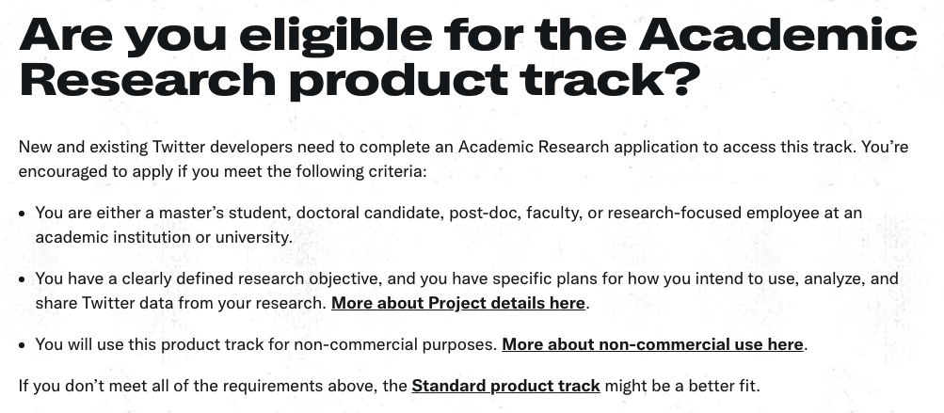
Kriteria

Slide 4
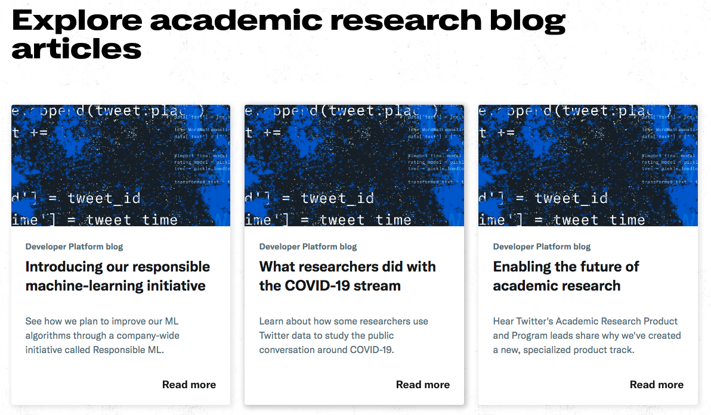
https://developer.twitter.com/en/use-cases/do-research/academic-research

Slide 5
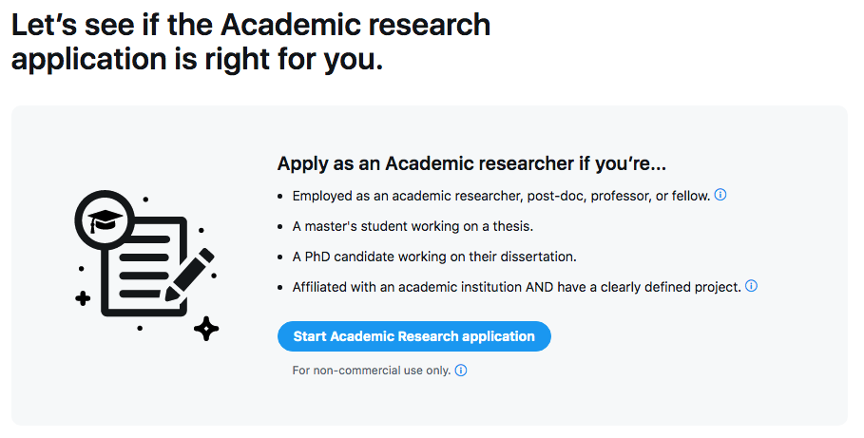
Pendaftaran
https://developer.twitter.com/en/portal/petition/academic/is-it-right-for-you

Slide 6
API Umum
https://developer.twitter.com/en/portal/dashboard

